Slide 1

Analyzing Restaurant Attributes to Predict Restaurant Closure

Slide 2

Agenda
1
Introduction
Literature Review
Data Understanding and Data Cleaning
Exploratory Analysis
Regression Analysis
Conclusion and Recommendations
Questions and Answers
2
3
4
5
6
7

Slide 3

Introduction

Slide 4
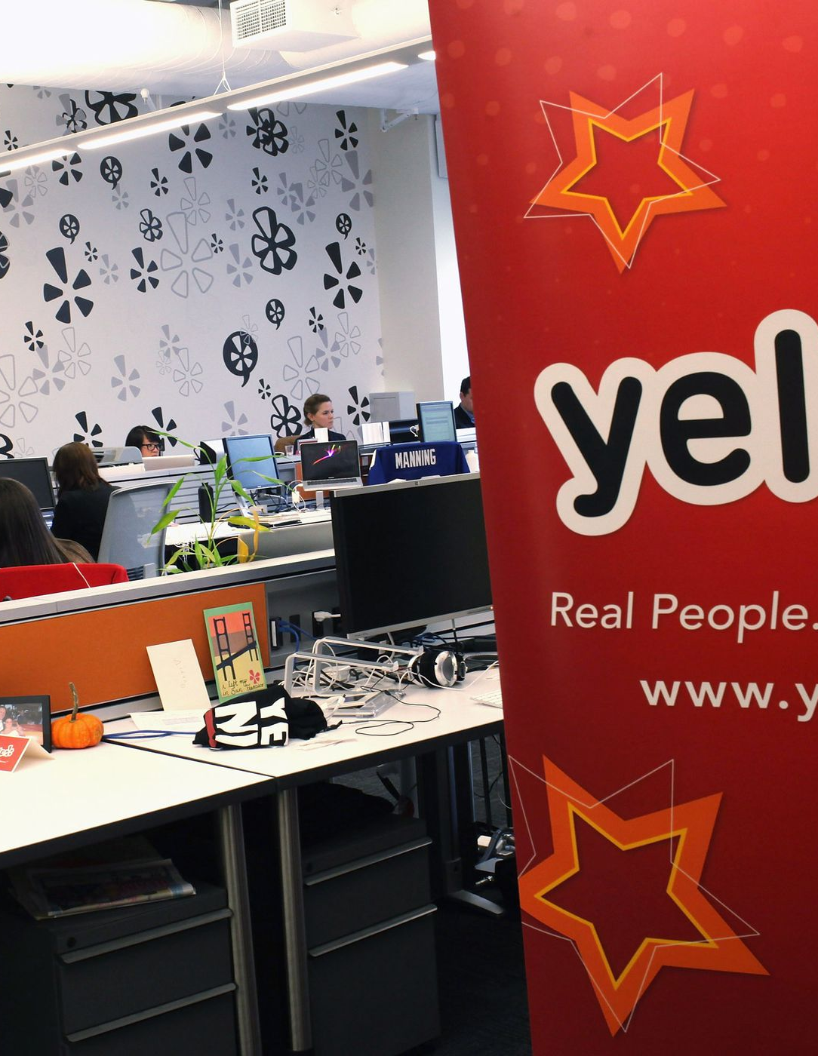
Company Background
Online crowd-sourced review forum, headquartered in San Francisco, California.
Founded in 2004 by former PayPal employees Russel Simmons and Jeremy Stoppelman.
Find local businesses like hair stylists, mechanics, dentist, etc.

Slide 5

Motivation
35 Million mobile app unique users (in Q1'20)
178 million Unique visitors monthly

Slide 6
Problem
Increase in new restaurants by 6%
Increase in competition
Increase in closure
 | 2018 | 2019
Number Of Restaurants | 33,110 | 35,305
Open | 23,118 | 23,867
Closed | 9,992 | 11,438
Note: This calculation only applies to restaurants on Yelp. Not all restaurants sign up on Yelp

Slide 7

Problem
The restaurant industry sees a 1% - 1.2% yearly increase in restaurants.
Restaurants that cannot compete also close each year.
In the spring of 2018, the U.S. restaurant count decreased by 1% from the year before.
(McLynn, 2018)

Slide 8

Research Questions
What have others found concerning this topic?
What important factors contribute to operation or closure of a restaurant? ​
How do these attributes impact the closure of a restaurant? ​

Slide 9


The Dataset
Yelp Dataset Challenge 2019​
209,393 businesses, 15 variables
35,305 restaurants
Arizona, Nevada, North Carolina,
Ohio, Pennsylvania​

Slide 10
Exploratory Analysis

Slide 11
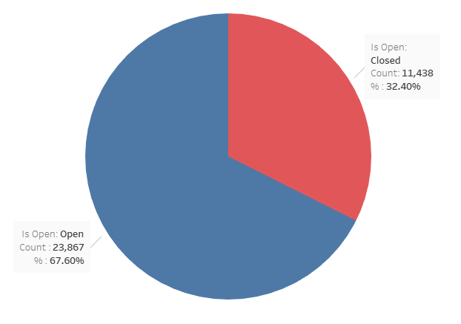
Target Variable "Is_Open"
1=Is Open
0=Is Not Open (or Closed)
67.60% of the target variable represent open restaurants, while 32.40% represent closed restaurants

Slide 12
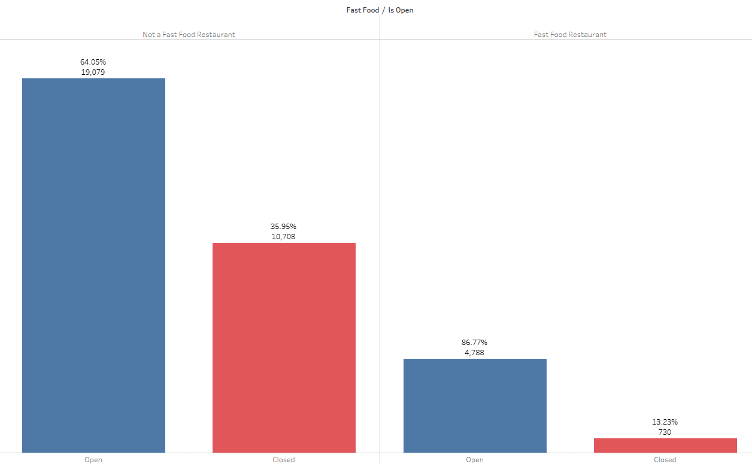
Fast Food
There are 5,518 (15.63%) fast food restaurants in the dataset while 29,787 (84.37%) of them are not fast food restaurants i.e., they are dining restaurants, café, buffet and so on.​
Almost a three times higher rate of closure in non fast food restaurants than in fast food restaurants.

Slide 13
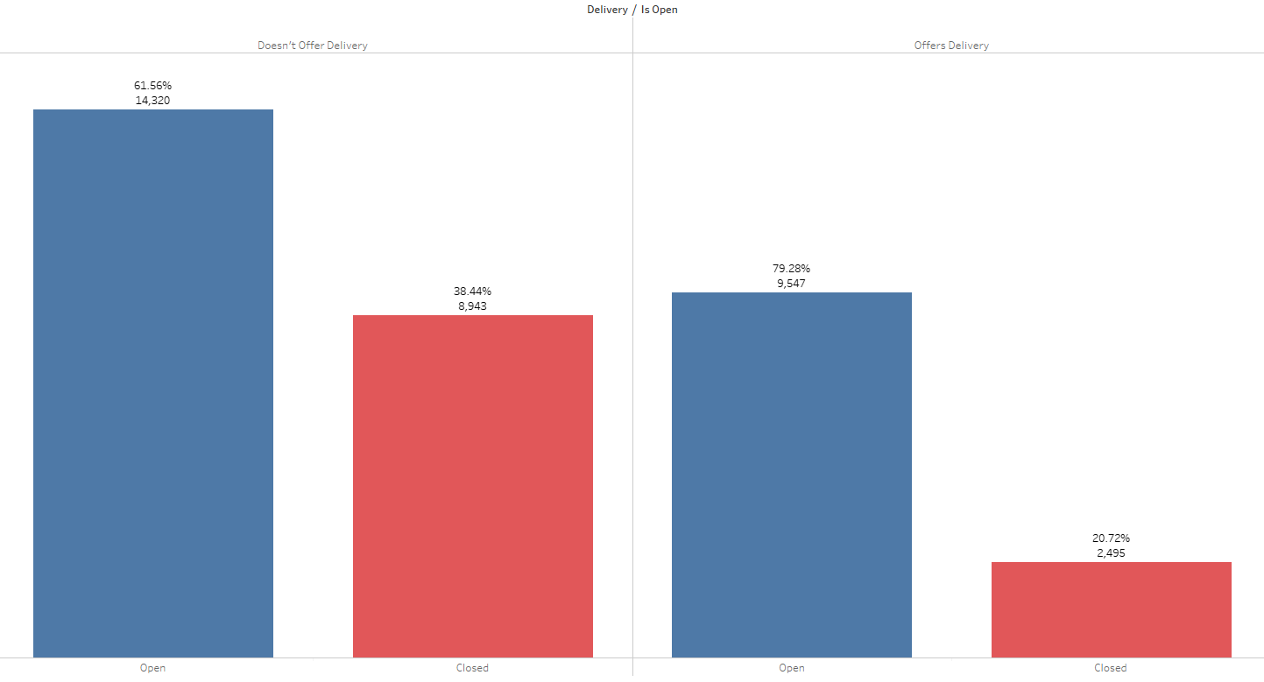
Delivery
That 20.72% of restaurants that offer delivery are closed (12,042 total delivery restaurants) while 38.44% of restaurants that do not offer delivery are closed (23,263 total non-delivery restaurants).
Delivery services are a popular dining option with U.S. consumers, as a November 2016 survey found that 20 percent of respondents use food delivery at least once a week.

Slide 14
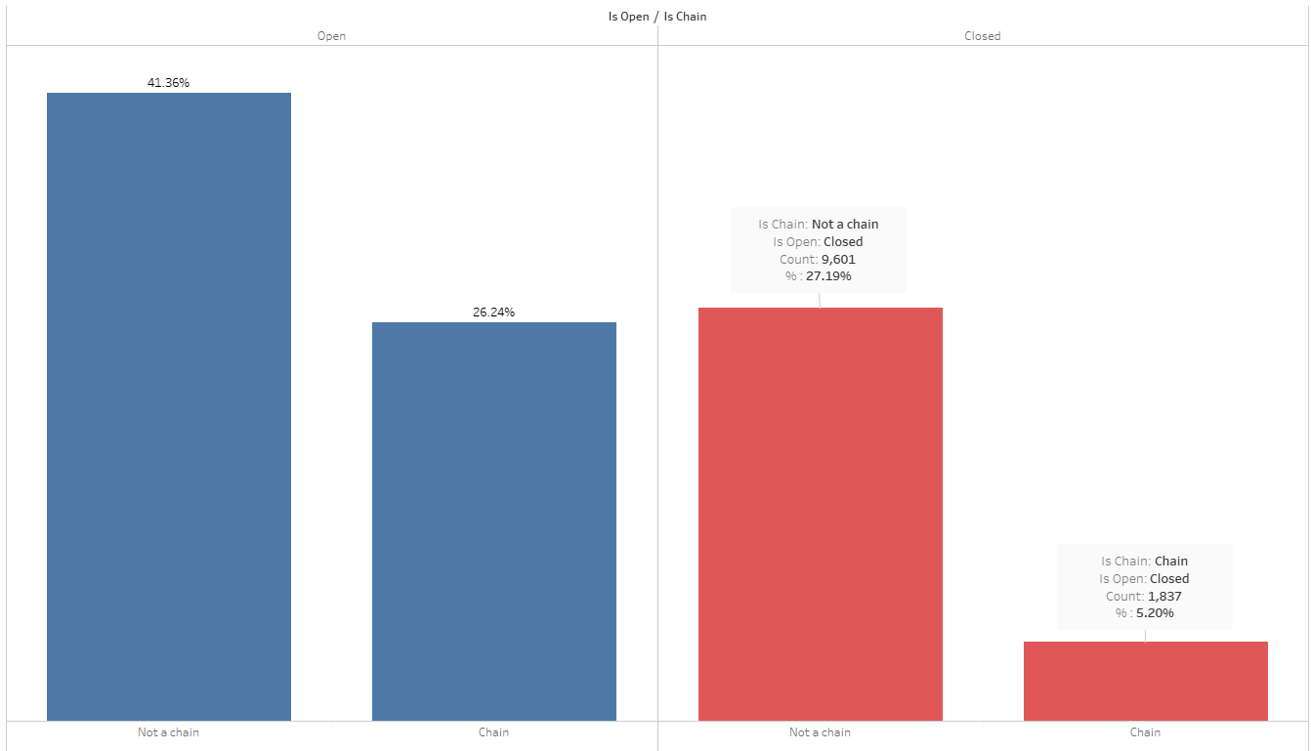
Chain Restaurants
There are 11,102 (31.45%) chain restaurants and 24,203 (68.55%) restaurants that are not classified as chain restaurants. 5.20% of closed restaurants are part of a chain and 27.19% are not.
"Large chains have the resources to ride out a protracted shutdown, but independent restaurants” find it harder to survive in same climate (Severson & Yaffe-Bellany, 2020).

Slide 15
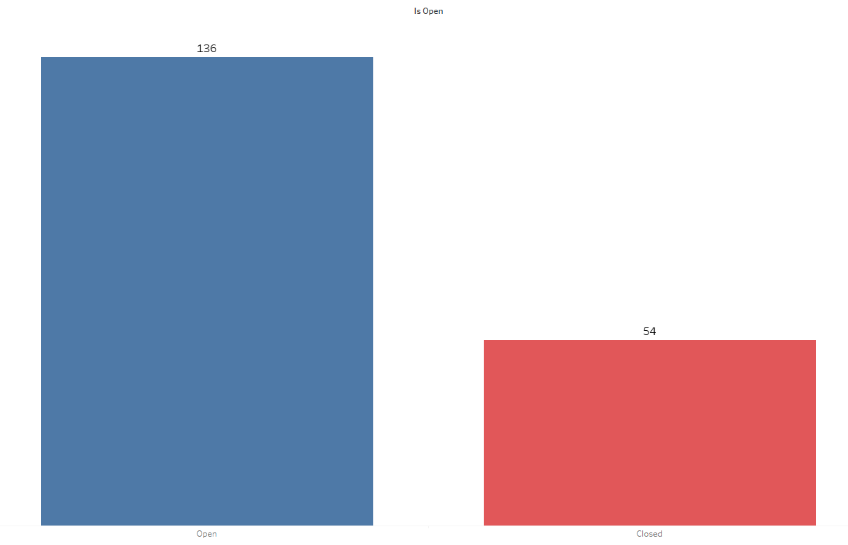
Average Reviews
The average number of reviews open restaurants have is 136 and the average for closed restaurants is 54 reviews

Slide 16
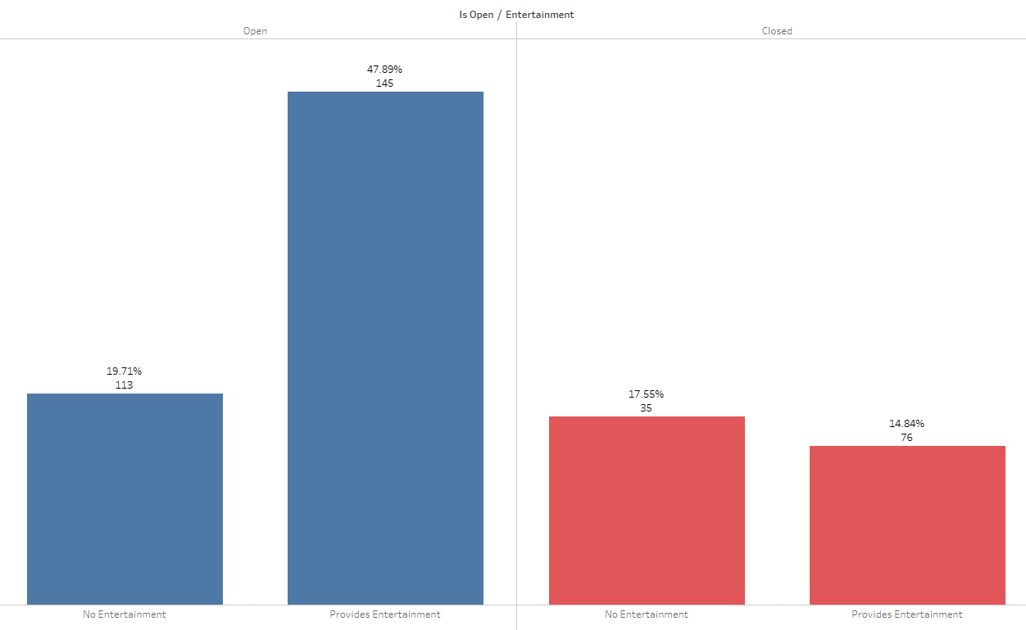
Entertainment and Reviews
In the dataset, 22,149 (62.74%) restaurants offer one or more forms of entertainment such as Background Music, Live Music, Jukebox and karaoke while 13,156 (37.26%) restaurants do not offer any entertainment.
There is a higher rate of closure in restaurants that do not provide entertainment. Experiences such as background music and other forms of entertainment are statistically significant predictors of satisfaction and repeat patronage (DiPietro 2016).
The closed restaurants have a lower number of reviews than restaurants that are open. This emphasizes the importance of reviews to the success of a restaurant.

Slide 17
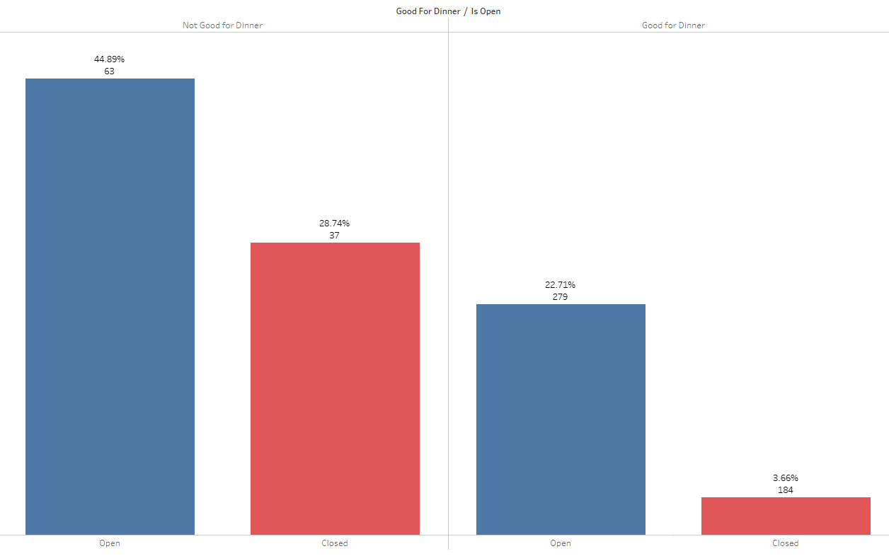
Good for Dinner and Reviews
There 25997 (73.64%) restaurants that are not good for dinner and 9308 (26.35%) that are good for dinner
There is a lower rate of closure for restaurants that are good for dinner.
Average reviews count is high for restaurants that are good for dinner

Slide 18
Regression Analysis

Slide 19

Stepwise Selection Regression
Variables Selected for the final model
Credit_ card | Reservations | Wifi | Stars
Delivery | Takeout | Wheelchair_access | LOG_review_ count
Entertainment | Alcohol | Price_Range | Noise_Level
FastFood | Good_for_ breakfast | Table_service | Happyhour
Is_chain | Good_for_ dinner | Parking | LOG_chain_ counts
Kid_ friendly | Good_for_ lunch | State
All 23 variables were selected
The Validation Misclassification rate is 0.199909
The model is 80.01% accurate
1332
3523
2197
10601
False Negative
True Negative
False Positive
True
Positive

Slide 20
Stepwise Selection Regression
Odds Ratio Estimates
LOG_Chain_ Counts 1.847
For each additional restaurant of a chain, the odds of staying open change by a factor of 1.847, or an 84.7% increase.
LOG_Review_Count 2.174
For each additional review, the odds of staying open is 2.174 higher.
Stars 1.337
For each additional unit of star, the odds of staying open changes by a factor of 1.337, or a 33.7% increase.
Entertainment 0.259
For restaurants without entertainment, the odds of staying open are 0.259 times or 74.1% lower than the odds of staying open for restaurants with entertainment.
Good_for_dinner 0.518
For restaurants that are not good for dinner, the odds of staying open are 0.518 times or 48.2% lower than the odds of staying open for restaurants that are good for dinner.

Slide 21
Conclusion and Recommendations

Slide 22

Conclusion
The 6 most importance variables for predicting restaurant closure according to the Regression analysis include:
Review Counts (the number of online reviews that each business has received)
Is_Chain (Indicating if the restaurant is a chain or not)
Chain Counts (count of all restaurants that are a part of the same franchise and have the same name)
Entertainment (Indicating if the restaurant provides entertainment or not)
Good_for_dinner (Indicating if the restaurant is good for dinner or not)
Stars (Indicating the start rating of the restaurant out of 5)

Slide 23

Recommendations
Independent restaurants at risk of closing can expand their business in order to grow in different locations or join a franchise to avoid closure. If this is not feasible, restaurants can also adopt the following recommendations.
Restaurants should provide entertainment such as background music, live music and TV (DiPietro, 2016) or improve the existing ones.
Promotions could be put in place to encourage customers to leave reviews and star ratings on yelp after visiting the restaurant. ("The restaurant owner who asked for 1-star Yelp reviews", 2020).
Restaurants that experience low traffic at dinner time and are considered "not good for dinner" can tailor their menu options to best suit customer needs.

Slide 24

Questions and Answers

Slide 25


Thank You!

